Slide 1
Atmospheric Chemistry and Air pollution
Chapter 3
Ground-level air pollution

Slide 2
Atmospheric pollutants
Definition
Primary and secondary pollutants
Reactivity in troposphere
Free radicals

Slide 3
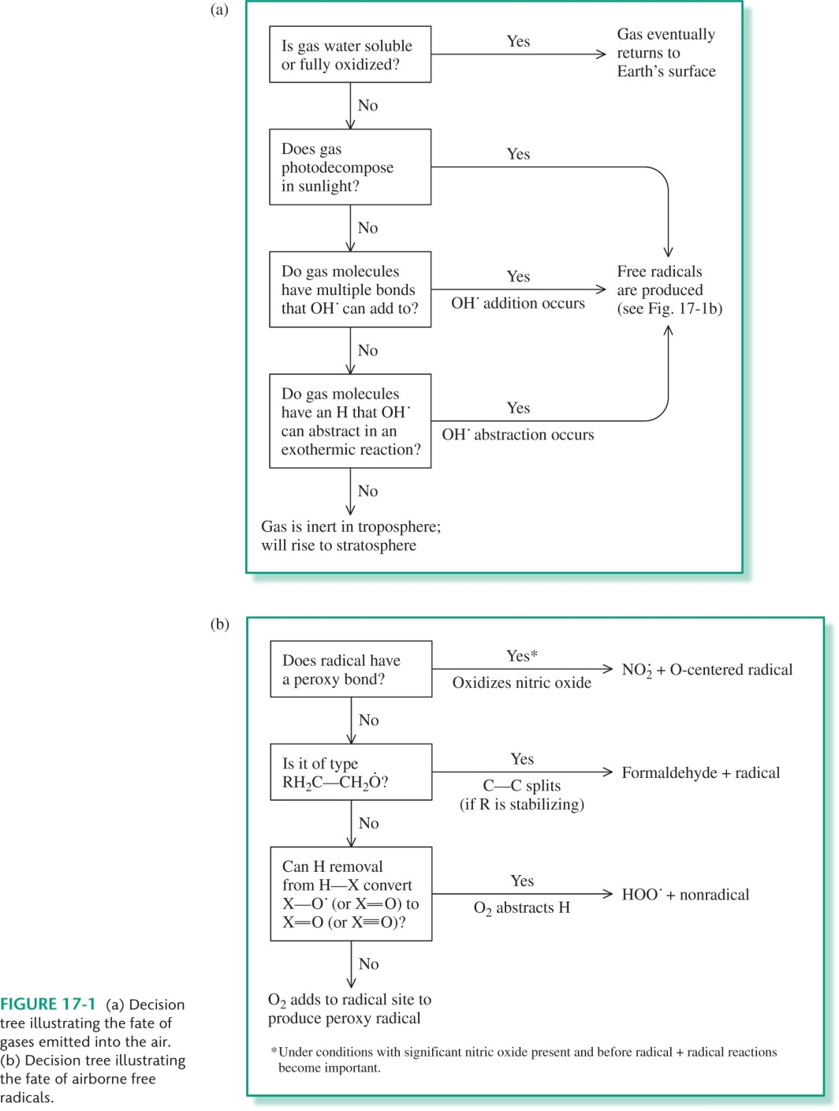

Slide 4
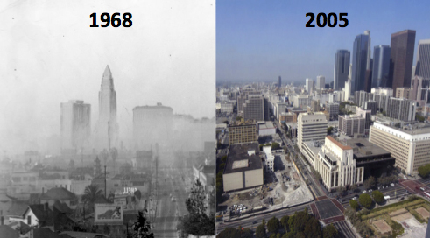
Photochemical smog
VOCs + NO + O₂ + sunlight →
Mixture O₃, HNO₃, organics

Slide 5
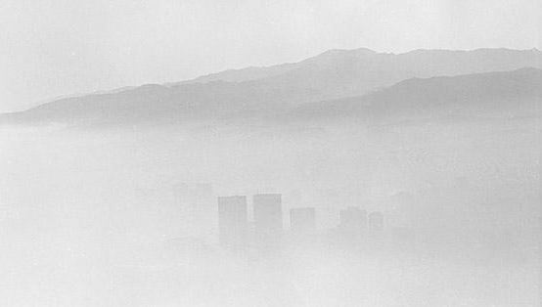
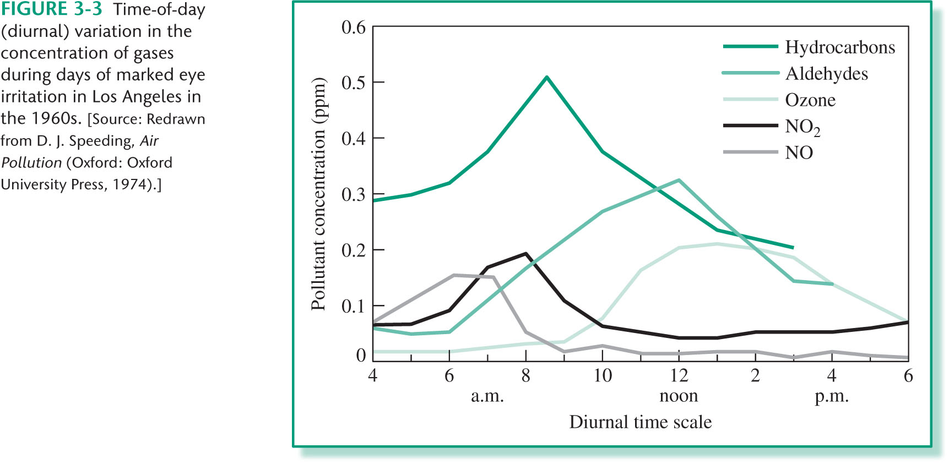
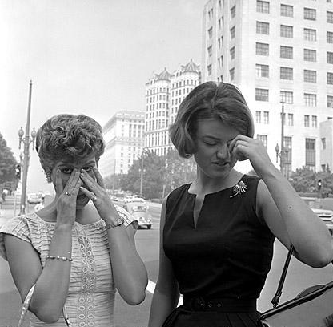
Photochemical smog

Slide 6
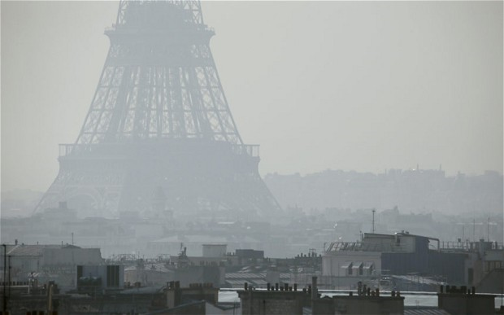
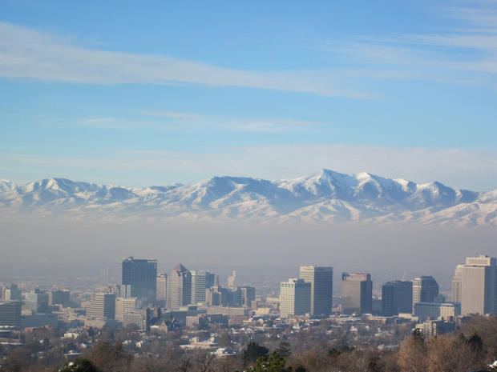
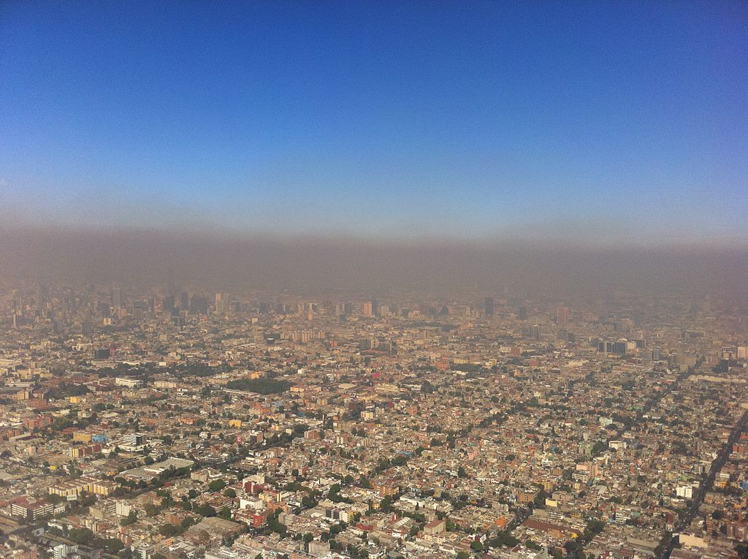
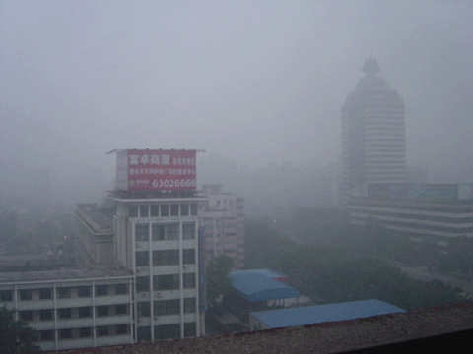
Paris
Mexico City
Beijing

Slide 7
Photochemical smog
VOCs + NO + O₂ + sunlight →
Mixture O₃, HNO₃, organics

Slide 8
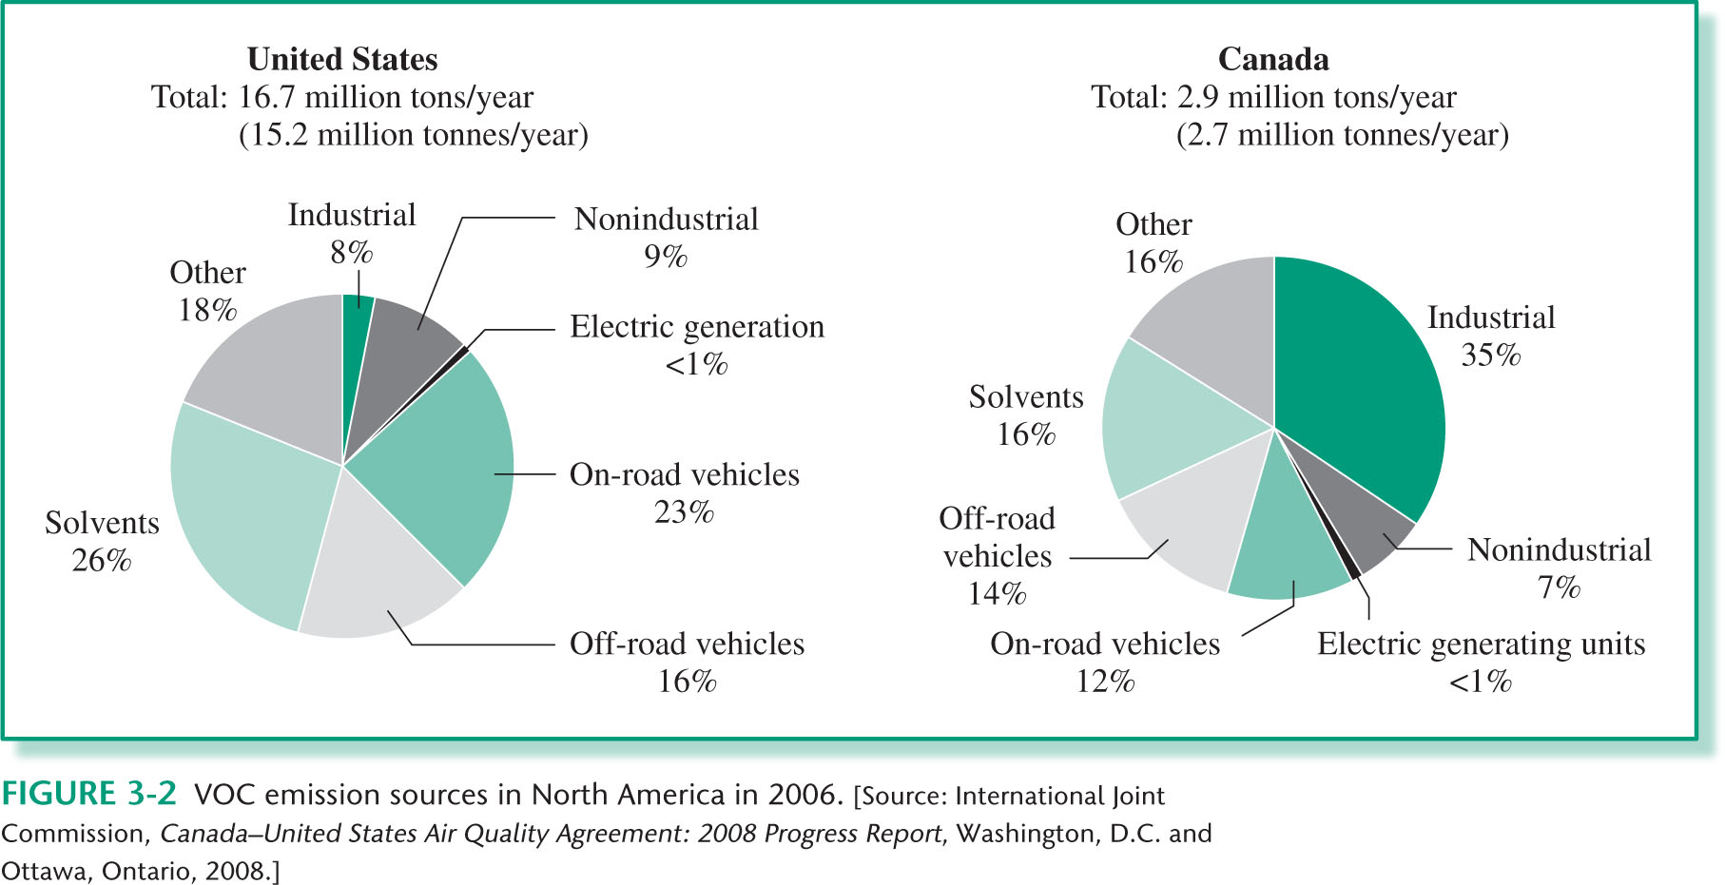
Photochemical smog
Volatile Organic Compounds

Slide 9
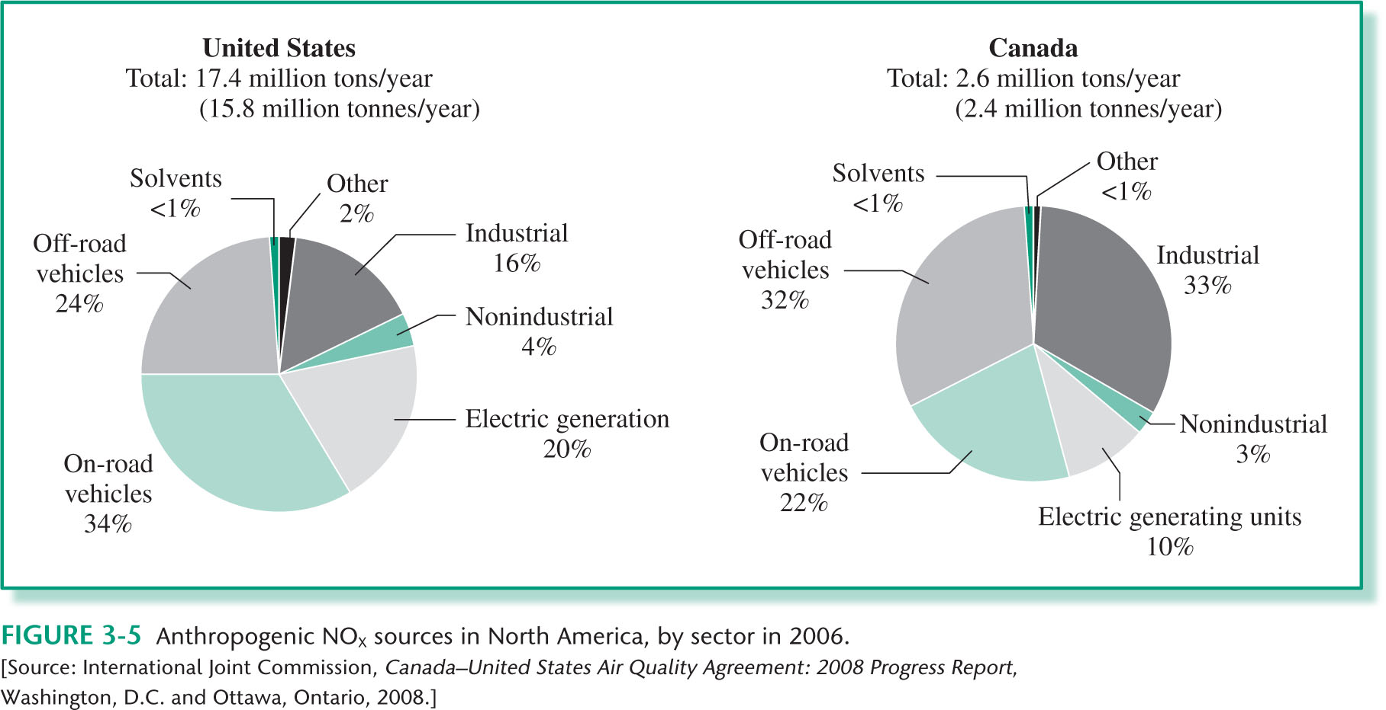
Nitrogen oxides
Fuel NO
Thermal NO

Slide 10
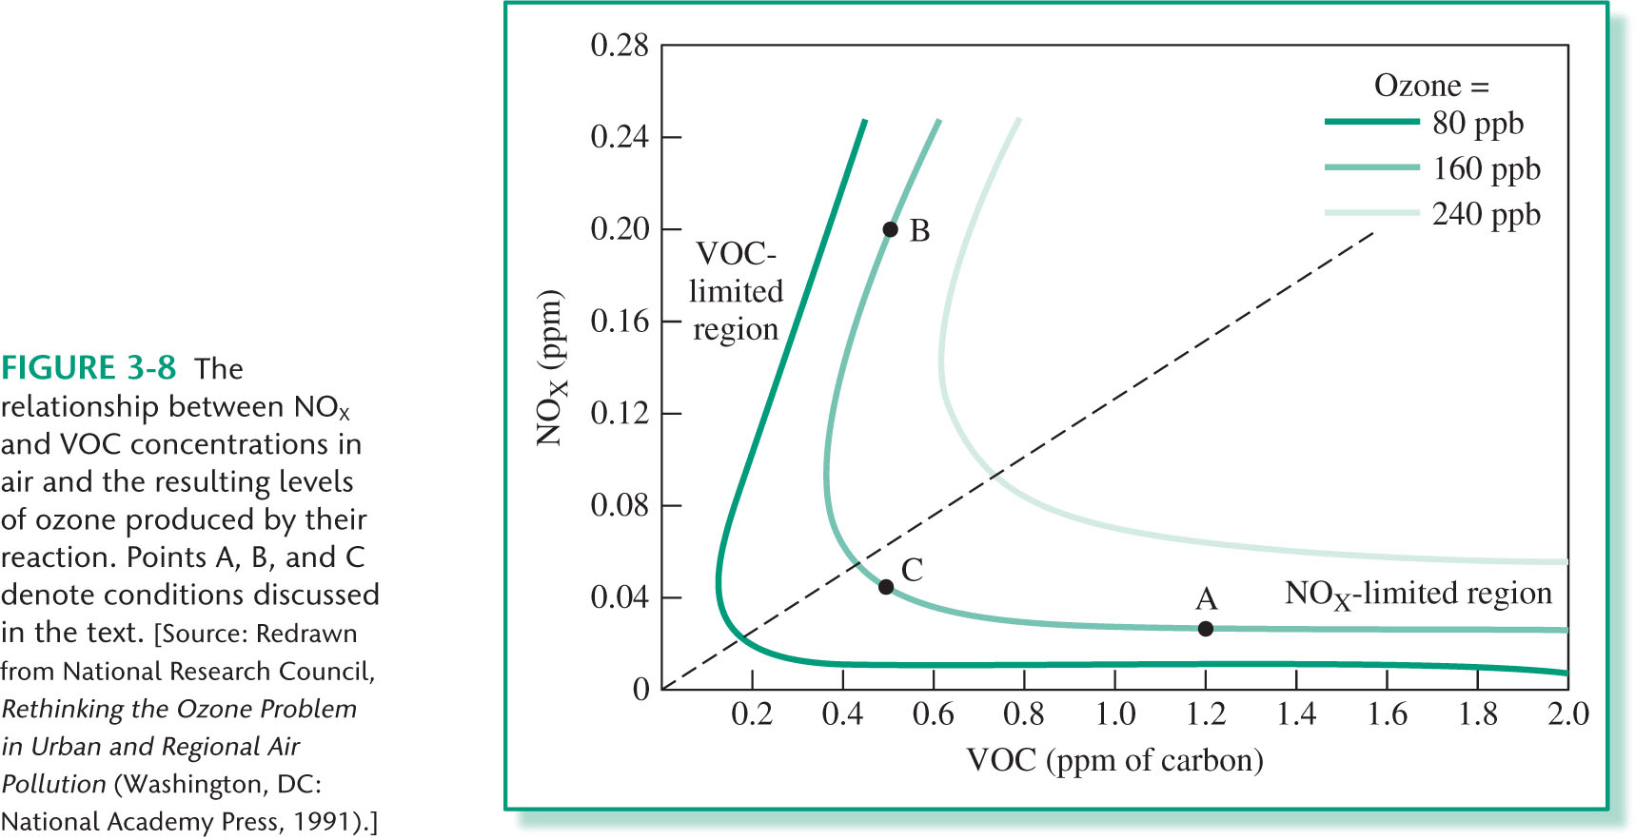
Limiting NO and VOCs

Slide 12
Reducing NOx and VOC_{S}
Vehicular traffic
Power plants
Solvents

Slide 13
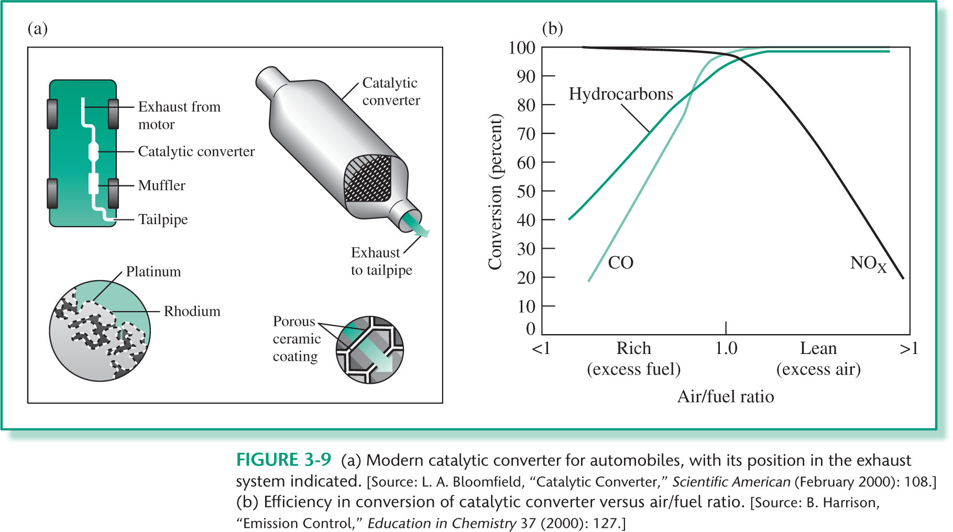
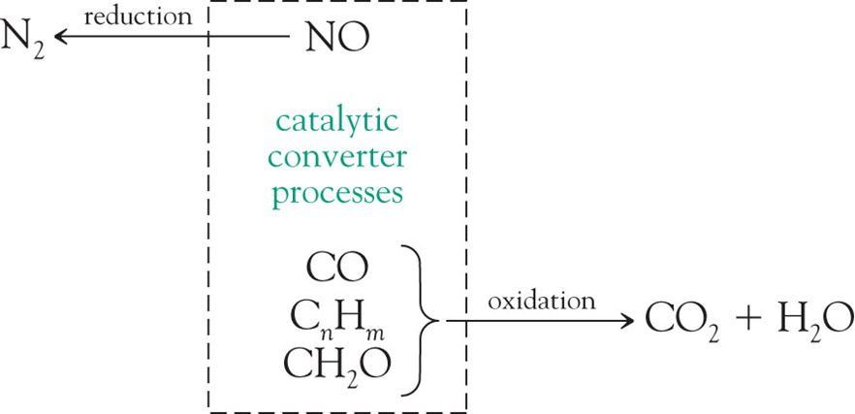
Gasoline engines - Catalytic convertors
Expensive
Reduce sulfur dioxide
Can be deactivated by sulfur-containing molecules
Do not convert start-up emissions

Slide 14
Power plants
Diesel engines - Catalytic convertors
Less effective
Do not convert NOx
Solid and liquid particles
Lower the temperature of the flame
Having the combustion of the fuel in stages
Catalytic convertors of NOx
Wet scrubbing of exhaust gases

Slide 15
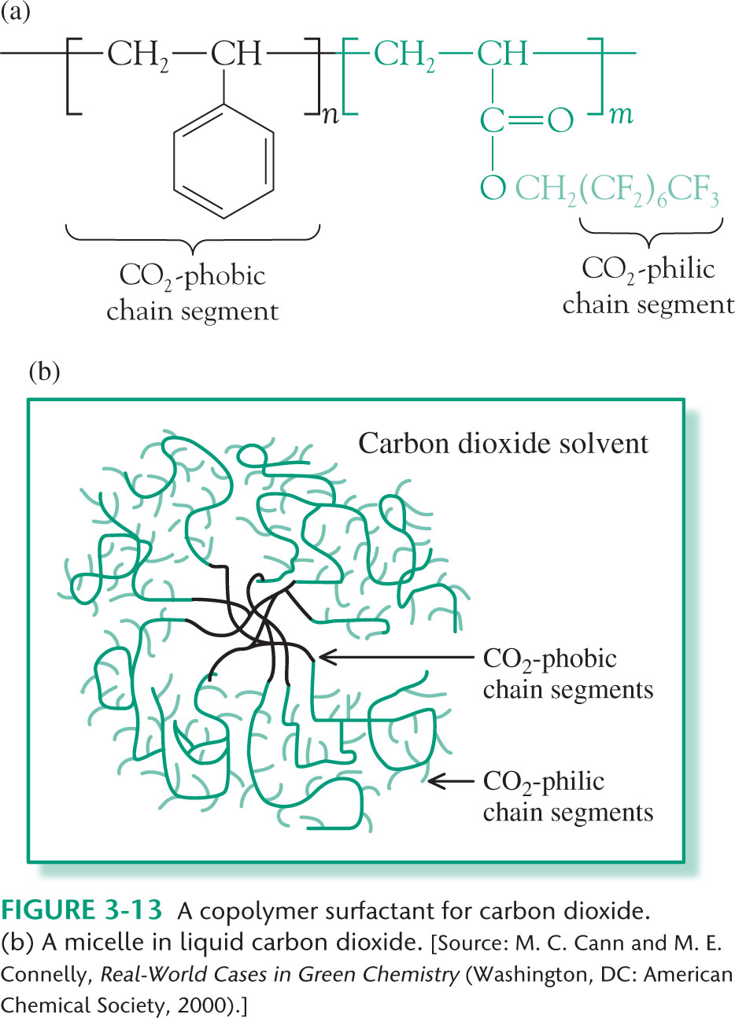
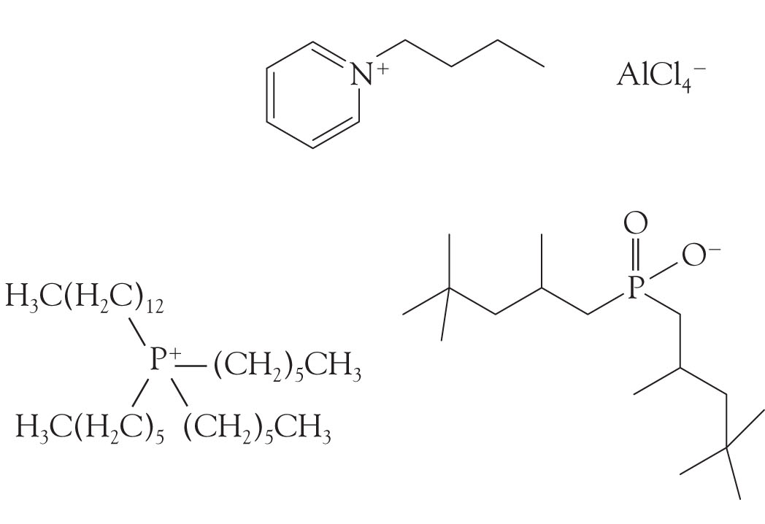
Solvents
Reduction of VOCs
Use latex-paint versus oil-based paints
Replace organic solvents
Supercritical and liquid carbon dioxide
Ionic liquids

Slide 16
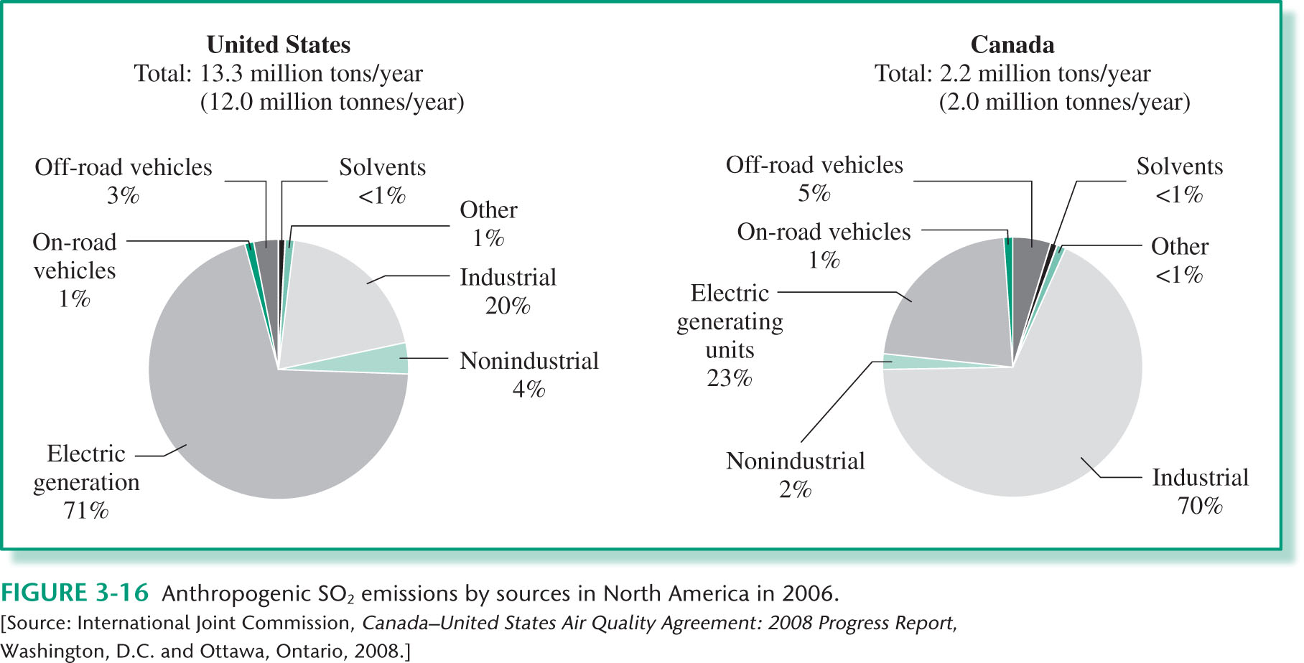
Sulfur-based emissions
SO₂
Combustion of coal

Slide 17
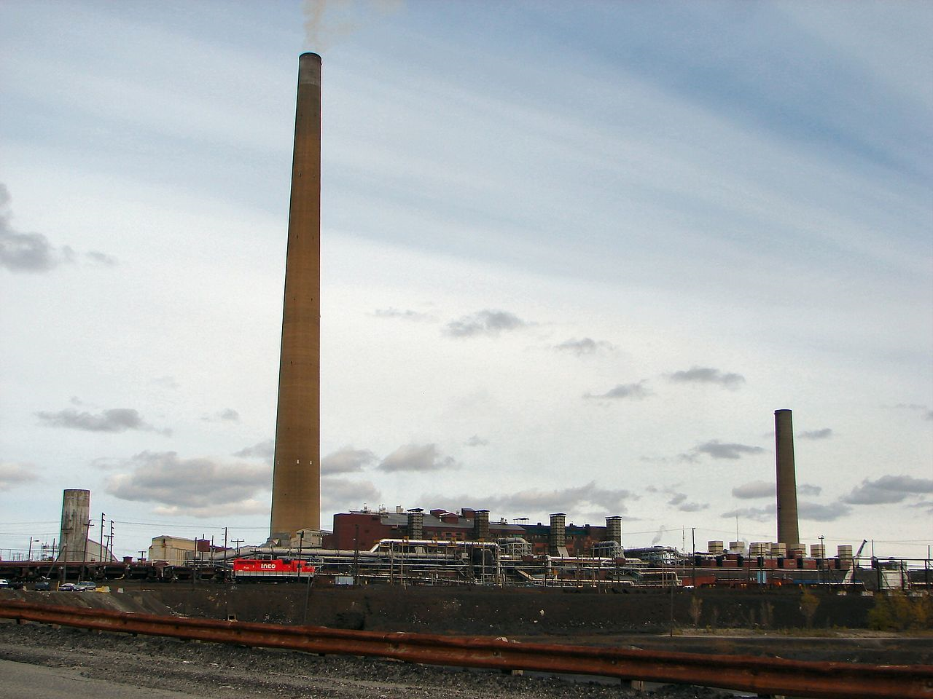
Sulfur-based emissions
SO₂
Smelting industry
H₂S

Slide 18
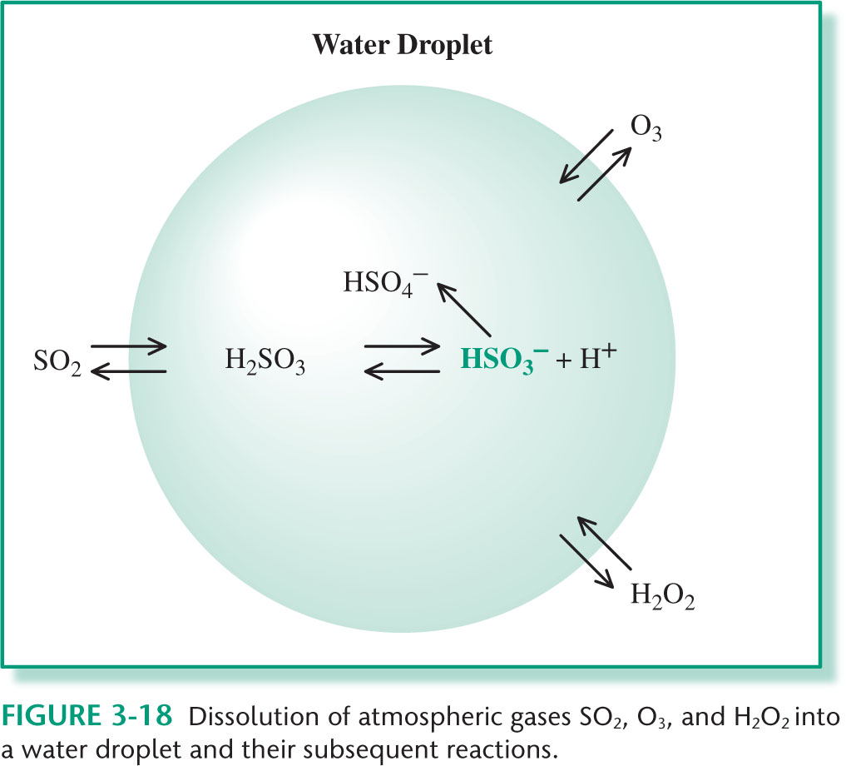
Sulfur-based emissions

Slide 19
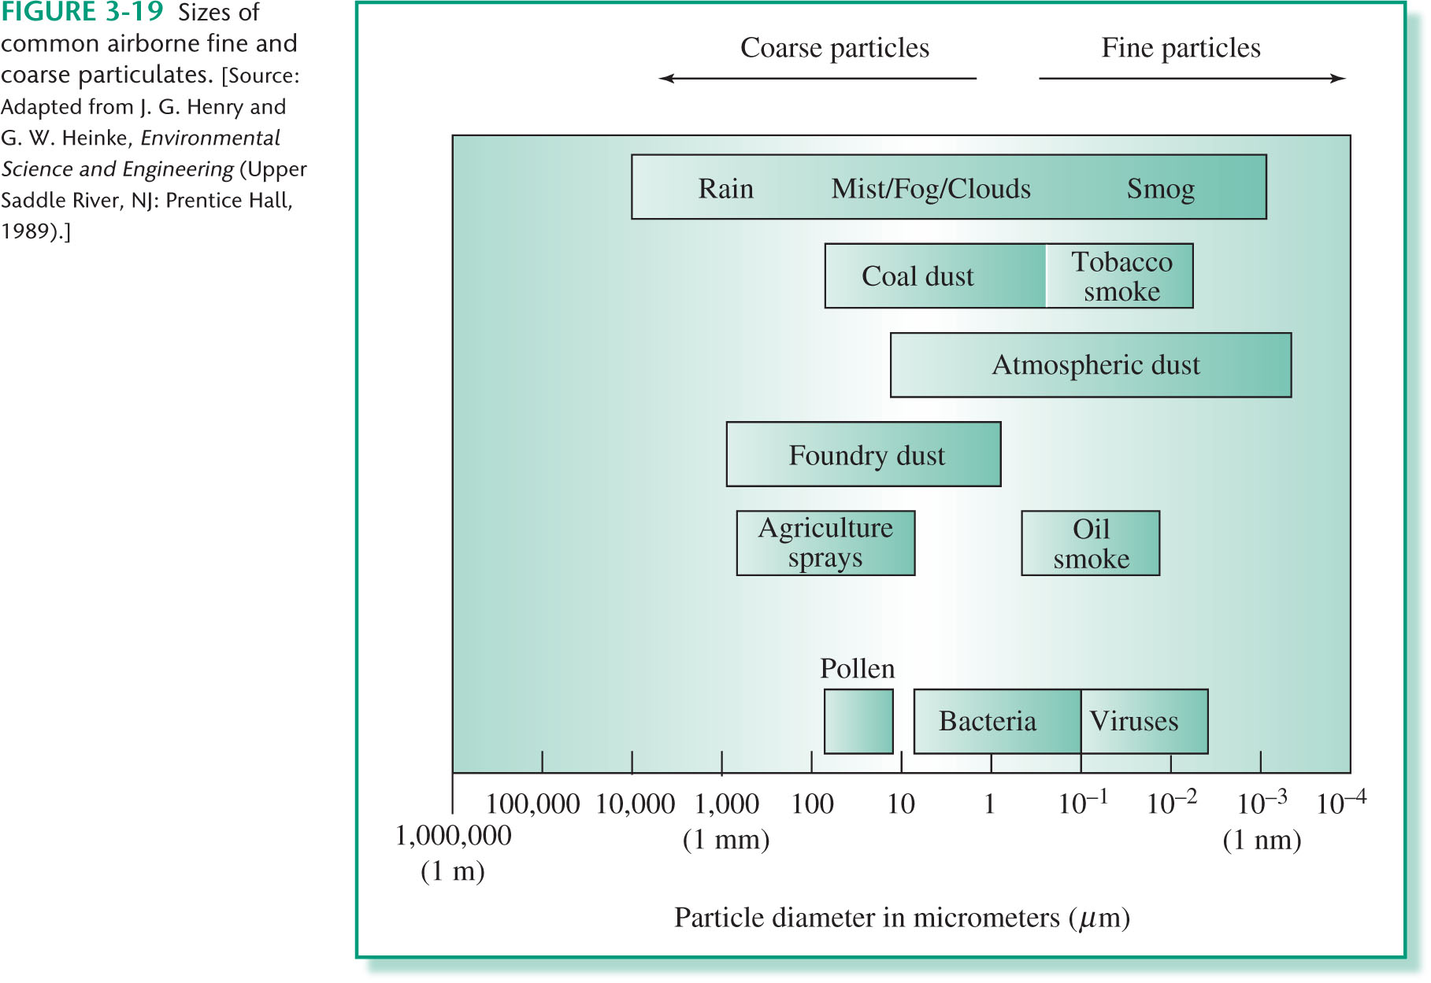
Particulates
Tiny solid or liquid particles temporarily suspended in air

Slide 20
Coarse particles - breaking up larger pieces of matter
Natural sources
Wind storms in desserts – fine sand into air
Wind – leaf litter
Pollen
Wildfires and volcanic eruptions
Oceans – sea-salt aerosols
Human activities
Fine particles – chemical reactions between gases or coagulation of smaller pieces of matter
Natural sources & Human activities
Exhaust from vehicles
Dust from metal smelting
Wearing of tires
Contain organic carbon but also inorganic compounds of nitrogen and sulfur

Slide 21
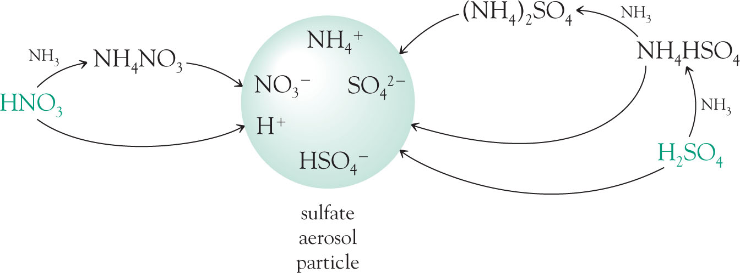
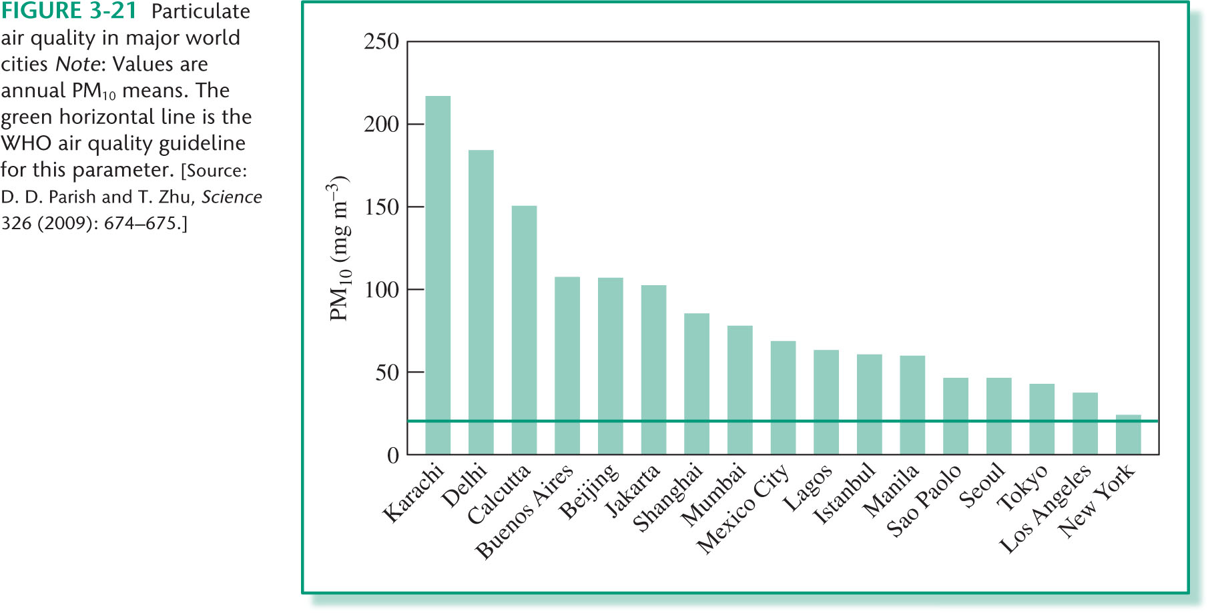
Particulates

Slide 22
Chapter 4
The Environmental and Health Consequences of Polluted Air

Slide 23
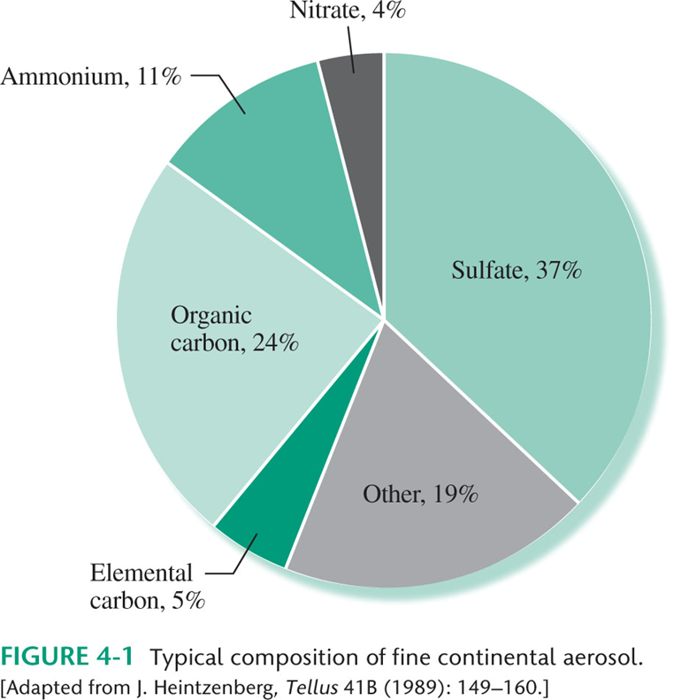
Haze

Slide 24
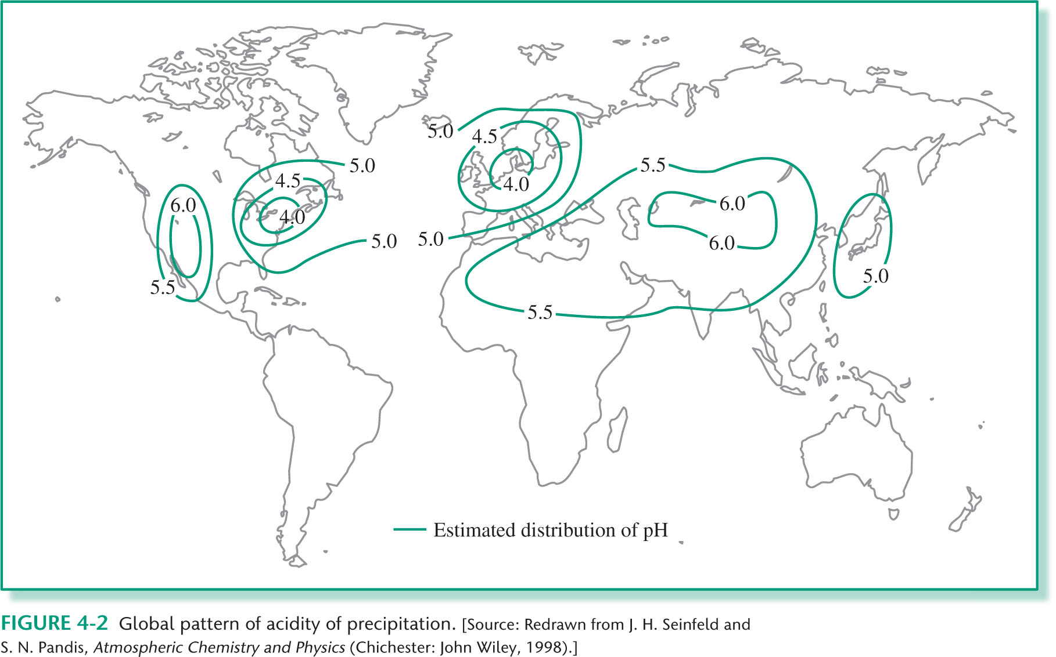
Acid Rain

Slide 25
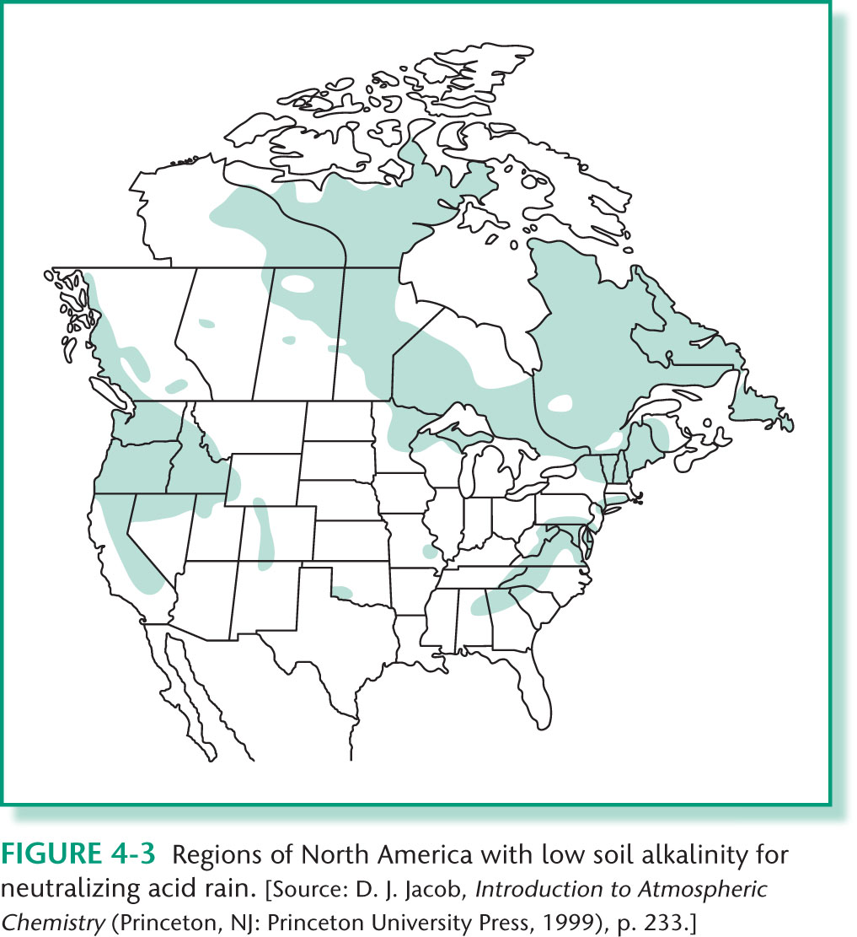
Acid Rain

Slide 26
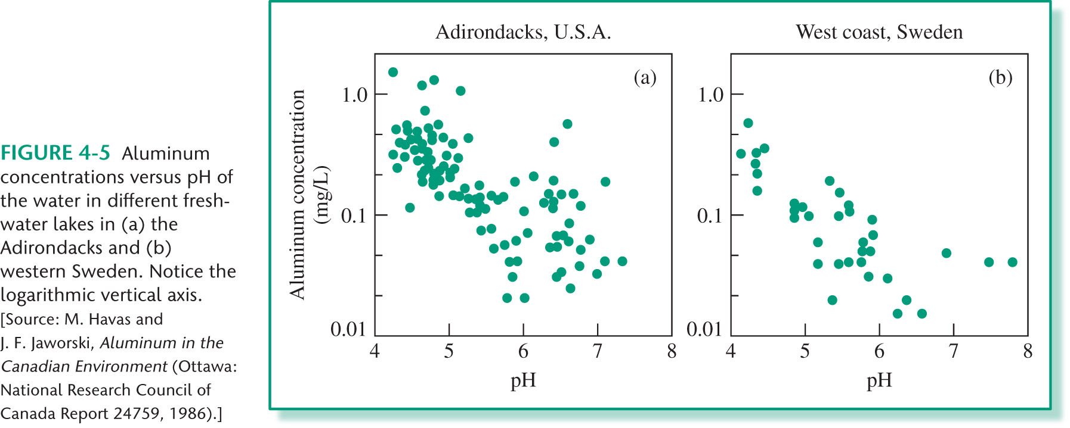
Acid Rain

Slide 27
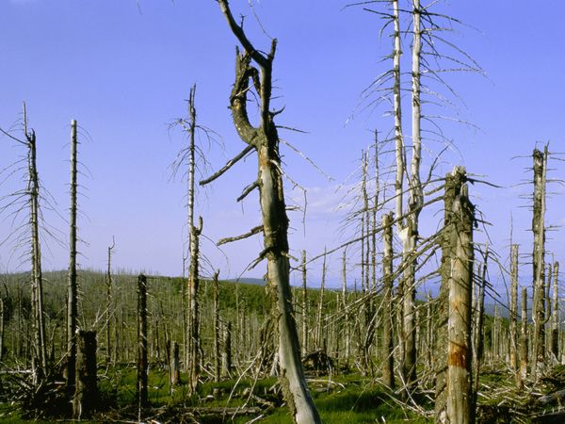
Acid Rain

Slide 28
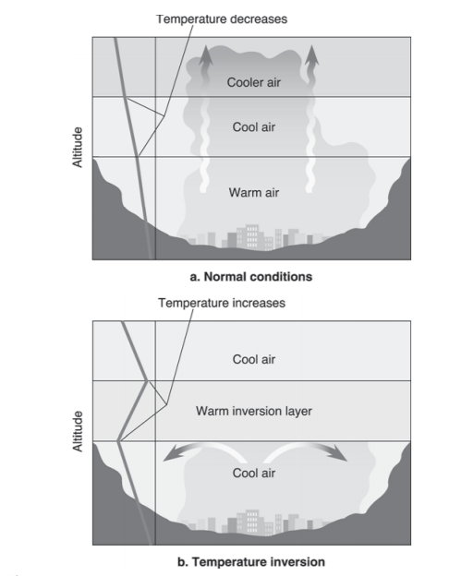
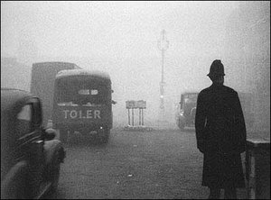
Outdoor pollution Soot and Sulfur dioxide smog

Slide 29
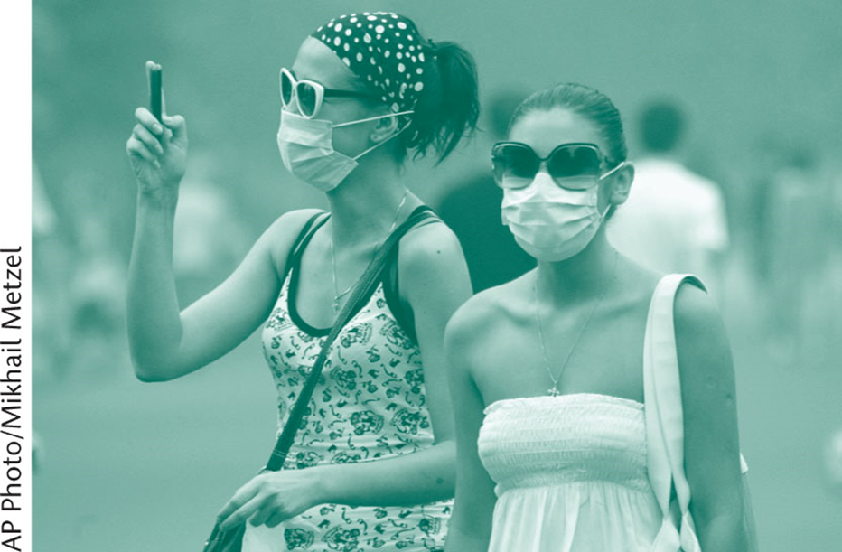
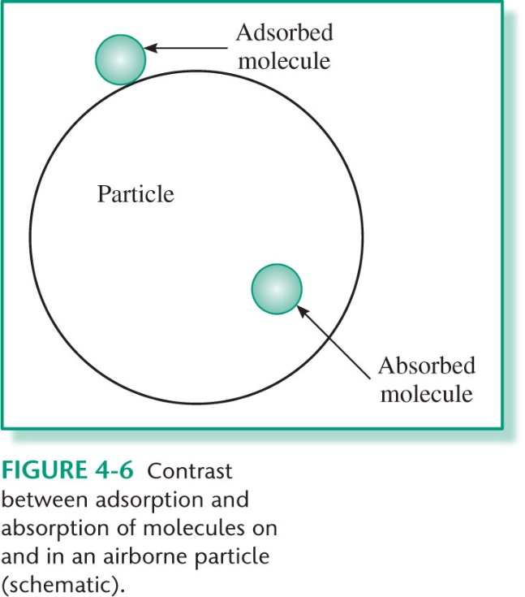
Photochemical smog
Particulates

Slide 30
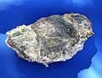
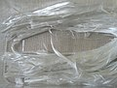
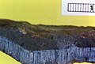
Indoor air pollution
Formaldehyde
Gasoline-related hydrocarbons
NO₂
CO
Environmental tobacco smoke
Asbestos

